Slide 1


CYBERSECURITY AUDIT & COMPLIANCE
INFO-7374
SOLUTIONS
PREPARING FOR AN ISO 27001 AUDIT

Slide 2



Table of Content
TASK 1: UNDERSTANDING INFO-7374’S ISMS FRAMEWORK
TASK 2: AUDIT PLANNING AND DOCUMENTATION REVIEW
TASK 3: CONDUCTING THE INTERNAL AUDIT – IDENTIFYING NON-CONFORMITIES
TASK 4: PREPARING AN ISO 27001 AUDIT REPORT
TASK 5: PRESENTATION & RECOMMENDATIONS

Slide 3


Scope of INFO -7374’s ISMS
Covers all cloud security solutions for financial institutions.
Protects infrastructure, data storage, transactions, authentication, and compliance.
Secures internal IT, access controls, and third-party interfaces.
2. Key Assets Covered Under ISMS
· Customer banking transaction data
· Authentication procedures (e.g., password, multi-factor authentication data)
· Financial regulatory reporting
· Cloud security infrastructure
· Employee access control systems
3. Critical Security Risks
· Unauthorized access due to weak access controls
· Data breaches from unencrypted customer records
· Regulatory non-compliance due to missing audit documentation

Slide 4




ISMS Policy
Risk Assessment
Report
Incident Response Plan
Mandatory Documents for ISO 27001 Audit
Statement of
Applicability
Access Control Policy
Objectives: Ensure compliance with ISO 27001, identify security gaps, and recommend corrective actions.
Expected Outcomes:
Documented risk assessments and security policies
Improved access control measures
Implementation of encryption and incident response procedures
a) Is an ISMS policy written down?
b) Have risk assessments been conducted and documented?
c) Are access controls applied and documented?
d) Is customer data encrypted in transit and at rest?
e) Is there an incident response plan?

Slide 5
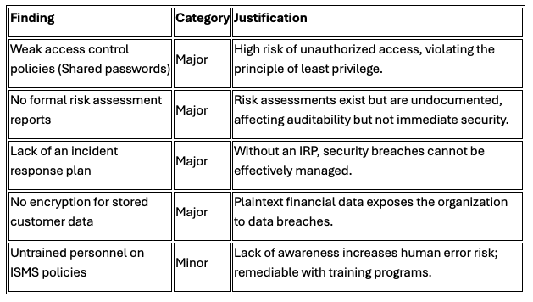

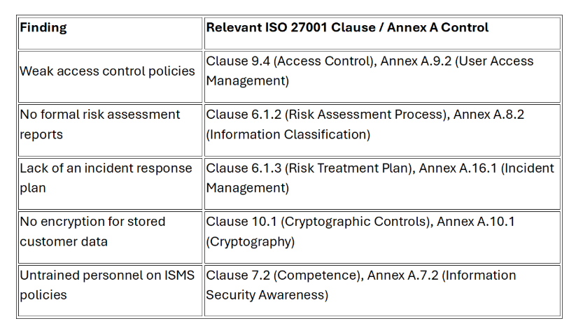


Slide 6
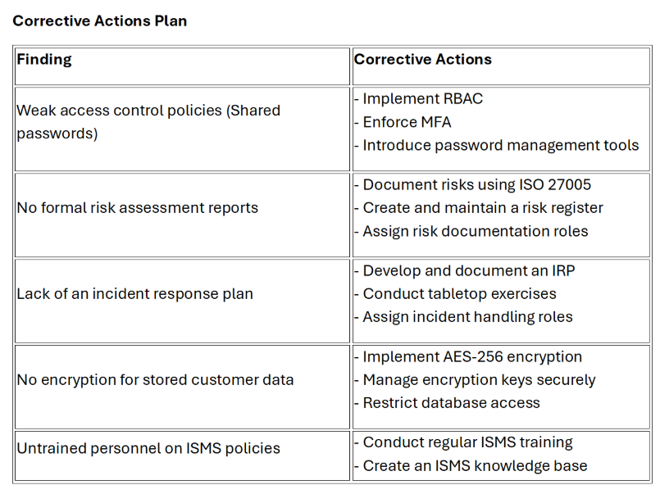




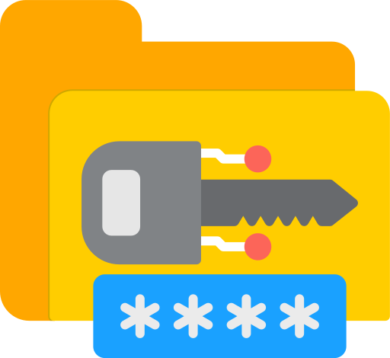

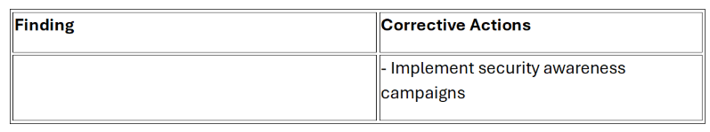

Slide 7

Audit Scope and Methodology
Scope
- INFO-7374 Solutions ISMS covering cloud-based cybersecurity services for financial institutions.
- Scope includes IT, Development, HR, Security Operations, and Legal.
Methodology
- Document Review
- Interviews
- Onsite Inspections
- Sampling
- Testing

Slide 8

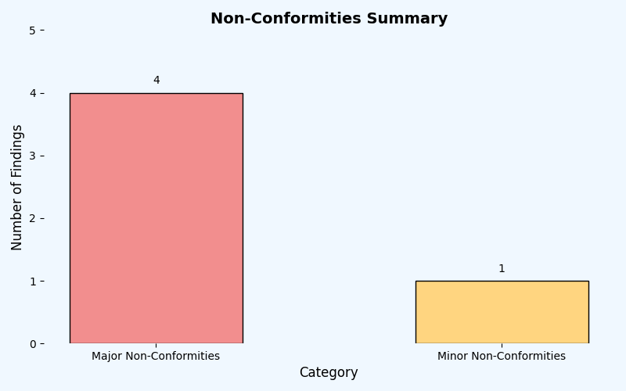
Findings
1. Shared Admin Passwords – Major Non-Conformity
2. No Formal Risk Assessment Reports – Major Non-Conformity
3. No Incident Response Plan – Major Non-Conformity
4. No Encryption for Stored Customer Data – Major Non-Conformity
5. Untrained Personnel on ISMS Policies – Minor Non-Conformity
Total Findings: 5
- Major Non-Conformities: 4
- Minor Non-Conformities: 1
Risk | Impact
Shared Admin Passwords | Major
No Risk Assessment Reports | Major
No Incident Response Plan | Major
No Encryption for Customer Data | Major
Untrained Personnel on ISMS | Moderate

Slide 9
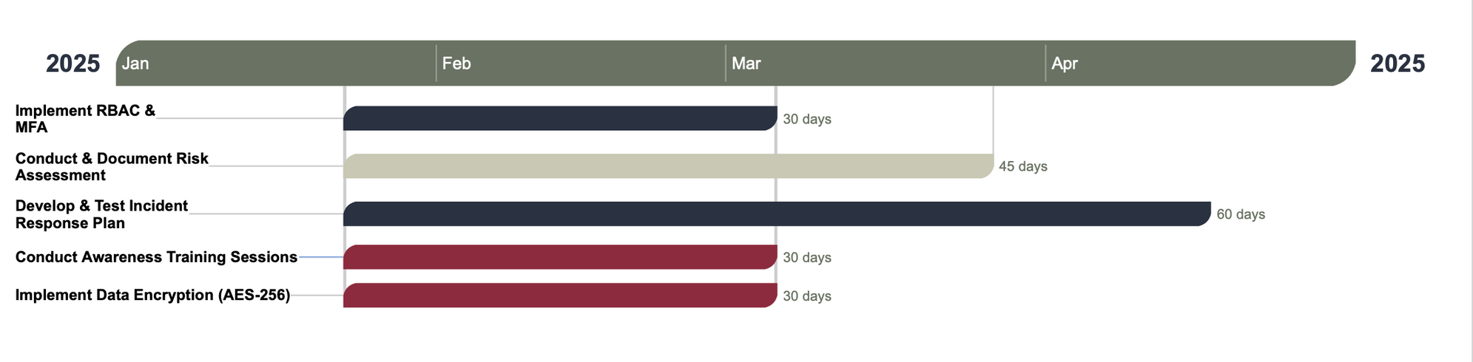
Actions and Timelines
1. Shared Admin Passwords
• Implement Role-Based Access Control (RBAC) and MFA
2. No Formal Risk Assessment Reports
• Conduct a comprehensive risk assessment
3. No Incident Response Plan (IRP)
• Develop and approve a formal Incident Response Plan (IRP)
4. No Encryption for Customer Data
• Implement encryption at rest and encryption in transit
5. Untrained Staff on ISMS Policies
• Conduct mandatory ISMS awareness training for all employees

Slide 10
THANK YOU
CYBERSECURITY TEAM
Krisha Lakhani
Devansh Manoj Thard
Ashok Kumar Reddy Naguri
Adish Shah

